Slide 1
Transformer
Attention Is All You Need
汇报人：王舟伟
脑所脑图谱中心 蔚鹏飞课题组
2023-04-27

Slide 2
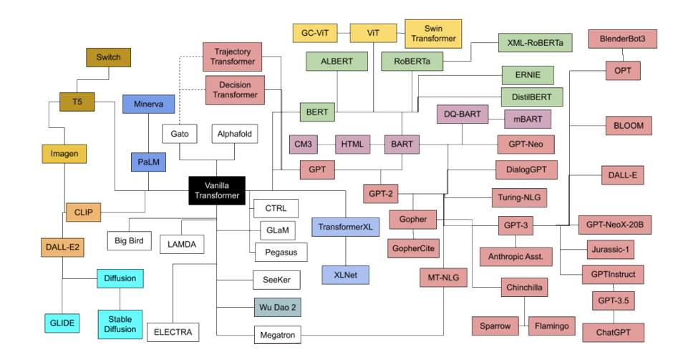
Transformers Family Tree
Figure 1: Transformers Family Tree

Slide 3
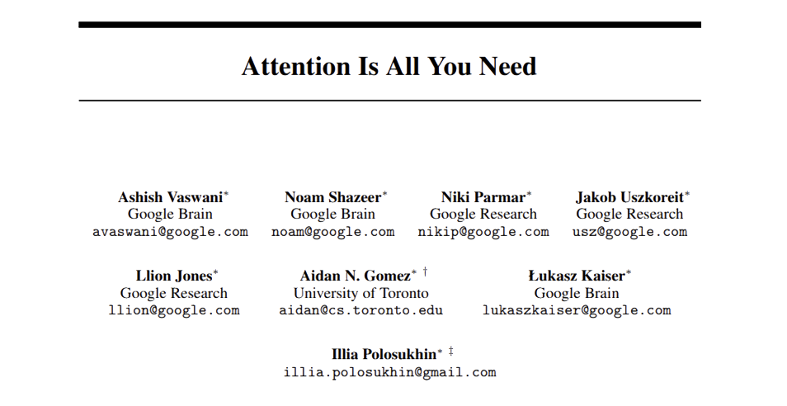
Transformer
Figure 2: Attention Is All You Need

Slide 4
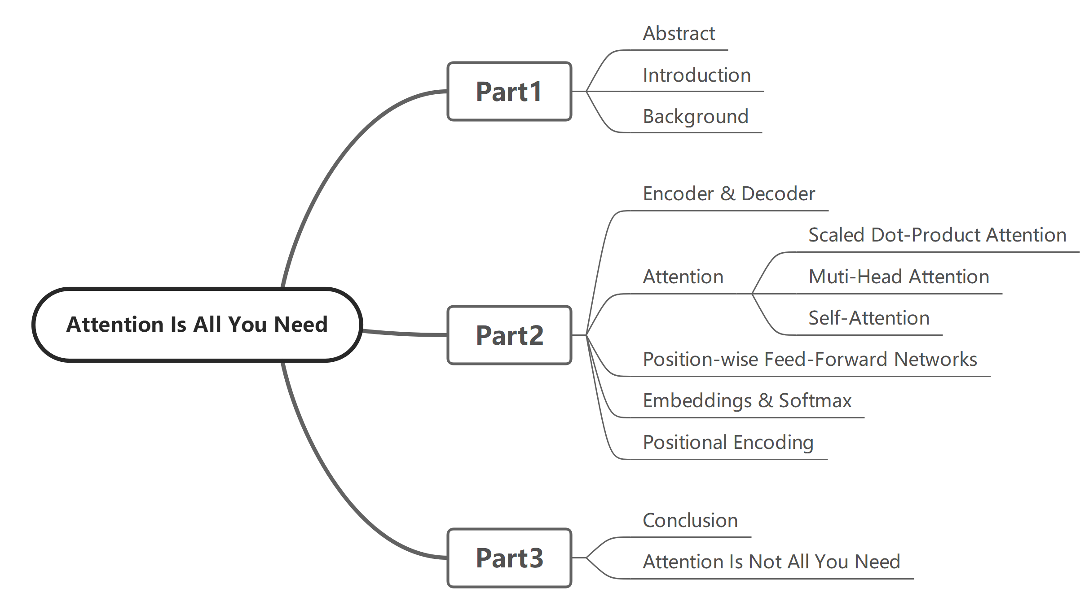
Mind Map
Figure 3: Mind Map of PPT

Slide 5
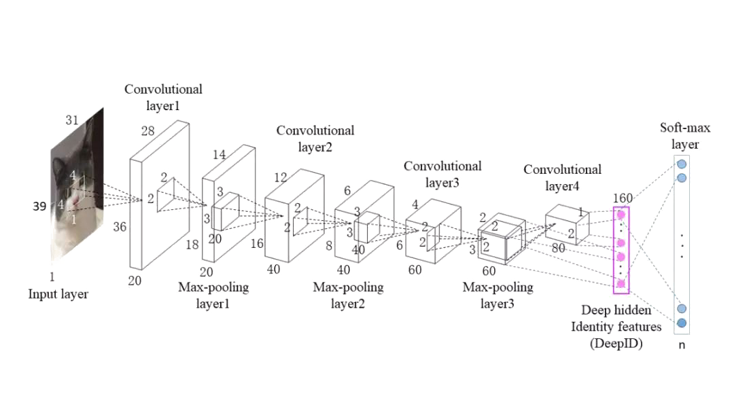
Before Transformer
The advantage of CNN is that it can have multiple output channels, each of which can identify different patterns.
However, CNNs have difficulty handling longer sequences well. The content processed each time is limited and many convolutional layers are needed to handle two distant blocks of content.
Figure 3: Architecture of a CNN
For RNNs, their output is determined by the hidden state of the previous moment and the input of the current moment.
Therefore, while it has temporal properties, it loses the ability to perform parallel calculations.
Figure 4: Architecture of a RNN

Slide 6
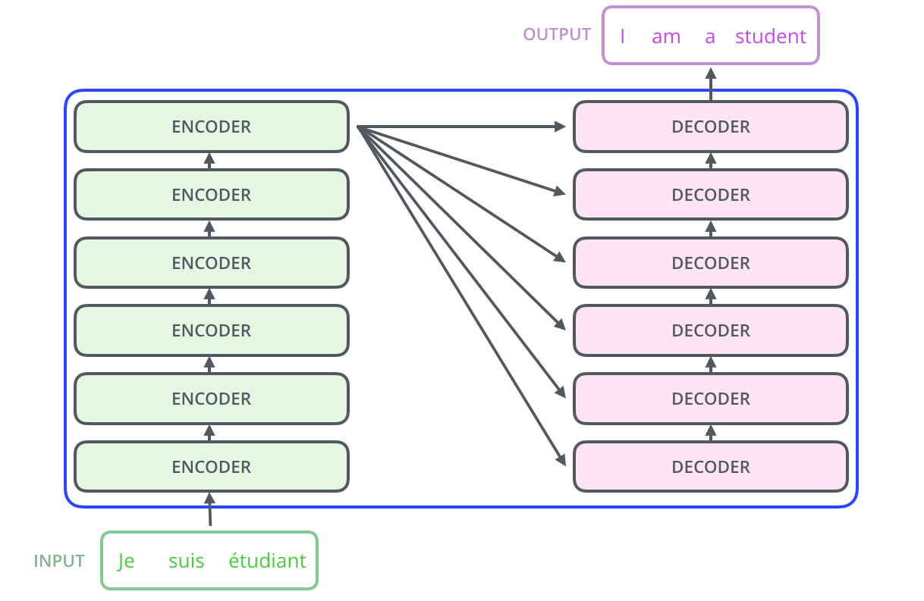
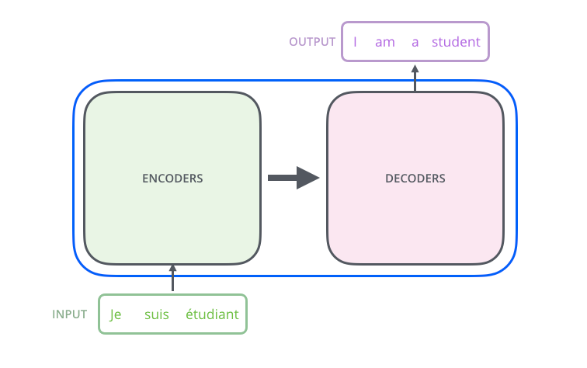
Encoder & Decoder
Figure 5: Encoder & Decoder 1
Figure 6: Encoder & Decoder 2

Slide 7
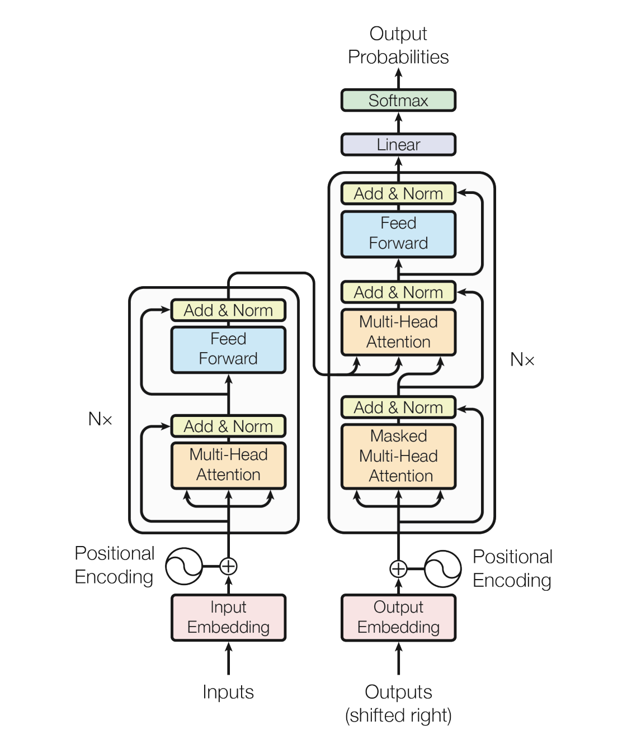
Encoder & Decoder
Decoder
Encoder
Encoder:
Represents the input $\left(x_{1},x_{2}, … , x_{n}\right)$
as $\left(z_{1}, z_{2}, … , z_{n}\right)$,
where each $z_{t}$corresponds to the vector representation of $x_{t}$​.
Decoder:
Generates $\left(y_{1}, y_{2}, … , y_{n}\right)$based on $z \text{and} \text{its} \text{output} \text{from} \text{the} \text{previous} \text{moment}$.
Figure 7: Architecture of the Transformer

Slide 8
Encoder
Hyperparameter:
$N$: the number of layers, $N=6$
$d_{model}$: the dimension of output, $d_{model}=512$
Structure:
Be composed of a stack of $N=6$identical layers.
Each layer has two sub-layers:
Multi-Head Attention
Feed Forward
Residual connections
Each sub-layer is followed by layer normalization:
$LayerNorm(x+Sublayer(x))$
Figure 7: Architecture of the Transformer

Slide 9
Decoder
Hyperparameter:
$N$: the number of layers, $N=6$
Structure:
Be composed of a stack of $N=6$identical layers.
Each layer has three sub-layers:
Masked Multi-Head Attention
Multi-Head Attention
Feed Forward
Residual connections
Each sub-layer is followed by layer normalization:
$LayerNorm(x+Sublayer(x))$
Auto-regressive
Figure 7: Architecture of the Transformer

Slide 10
Encoder & Decoder
Figure 8: Encoder & Decoder 3

Slide 11
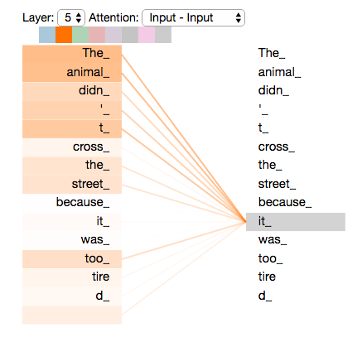
Self-Attention
Parameter:
Query：Input $X$
Key：Input $X$
Value： Input $X$
Process:
The process of attention is to calculate the similarity between the Query and the Key. The greater the similarity, the greater the corresponding weight. Then, the weighted sum of the Values corresponding to the Key is the output.
Function:
Additive Attention
Dot-Product Attention
Figure 9: Self-Attention

Slide 12
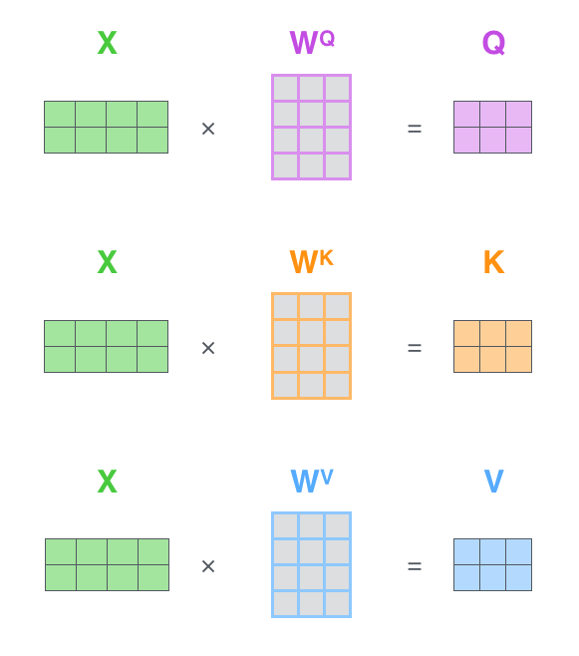
Dot-Product Attention
Figure 10: Dot-Product Attention Step 1-1

Slide 13
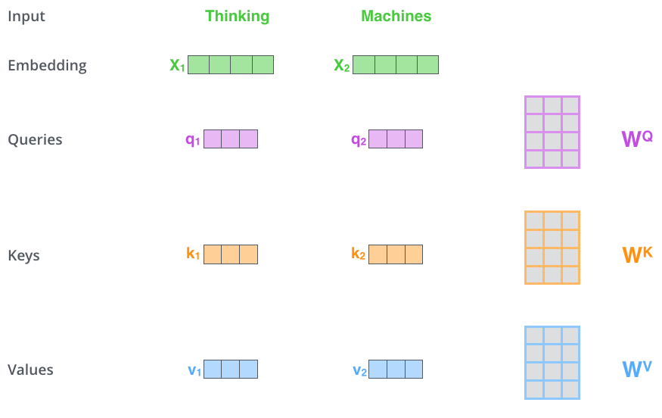
Dot-Product Attention
Figure 11: Dot-Product Attention Step 1-2

Slide 14
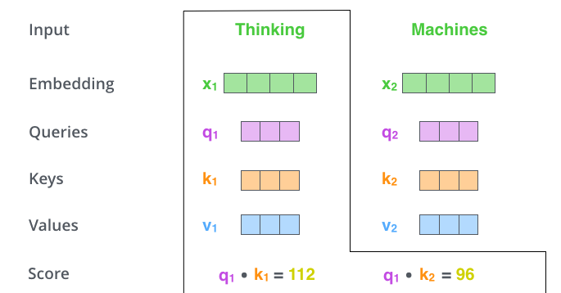
Dot-Product Attention
Figure 12: Dot-Product Attention Step 2

Slide 15
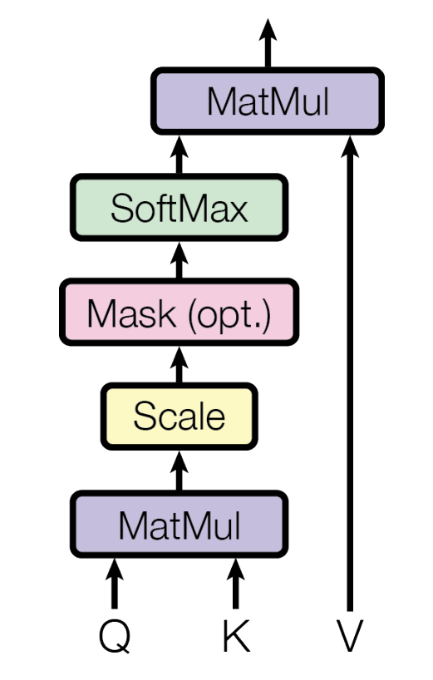
Scaled Dot-Product Attention
To avoid the Decoder from seeing the input after time t.
Turn the data after time $t$into a very large negative number
Divide by $\sqrt{d_{k}}$
Previous Page
To avoid the result of the previous multiplication from being too large and causing extreme values after passing through the softmax, which can result in a small gradient that prevents further calculation.
Figure 13: Scaled Dot-Product Attention

Slide 16
Scaled Dot-Product Attention: SoftMax
Use the exponential function on each element of the matrix to ensure that there are no negative numbers while retaining information.
Sum each row of the matrix to obtain normalization constants.
Divide each value in the matrix by the normalization constant so that the sum of each row of the matrix is 1.
$$softmax\left(X_{ij}\right)=\frac{exp\left(X_{ij}\right)}{\sum_{k}{exp\left(X_{ik}\right)}}$$
Figure 13: Scaled Dot-Product Attention

Slide 17
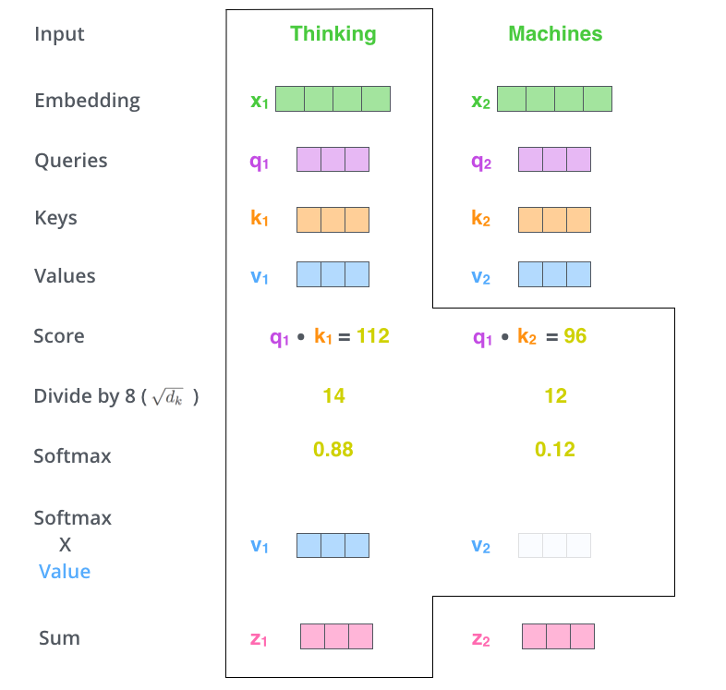
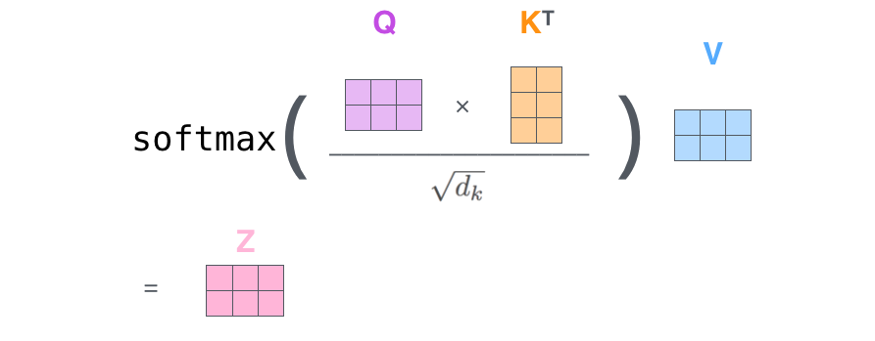
Scaled Dot-Product Attention
Figure 14: The Formula for Scaled Dot-Product Attention
Figure 15: Scaled Dot-Product Attention

Slide 18
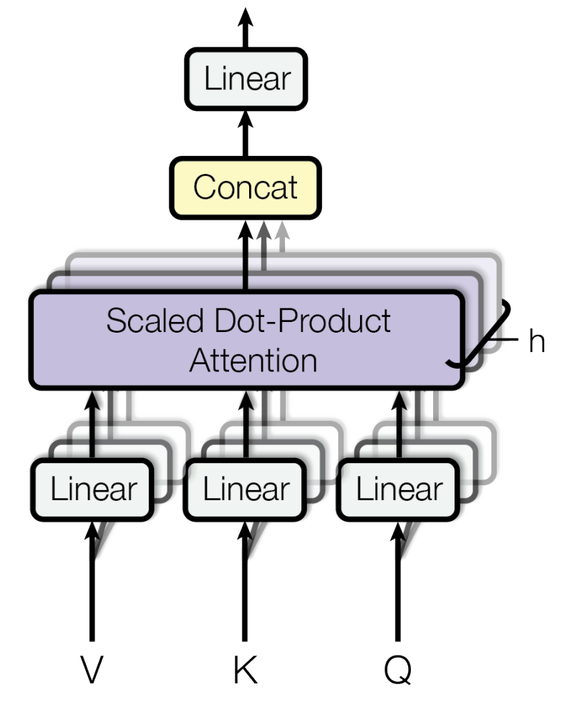
Multi-Head Attention
Hyperparameter:
$h$: the number of heads, $h=8$
Figure 13: Scaled Dot-Product Attention
Figure 16: Multi-Head Attention

Slide 19
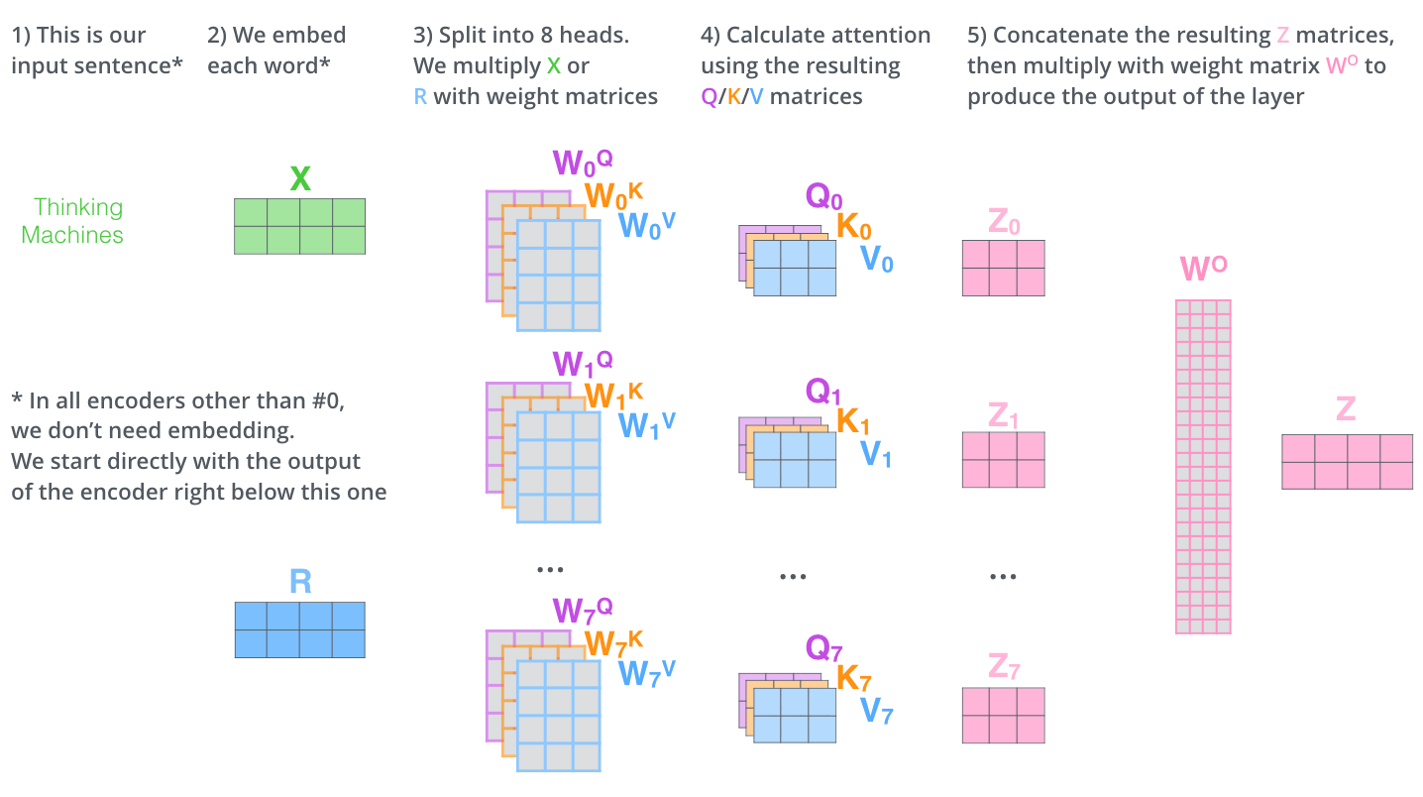
Multi-Head Attention
Figure 17: The Process of Multi-Head Attention

Slide 20
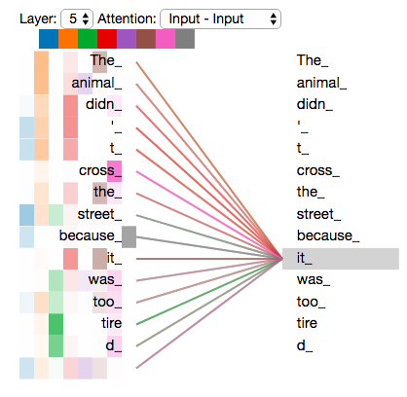
Multi-Head Attention
Figure 9: Self-Attention
Figure 18: Multi-Head Attention

Slide 21
Position-wise Feed-Forward Networks
Adding non-linear factors to the model to enable it to handle more complex information.
Linear Layer
$$FFN\left(x\right)=max\left(0 , xW_{1}+b_{1}\right)W_{2}+b_{2}$$
ReLU
Linear Layer
Figure 7: Architecture of the Transformer

Slide 22
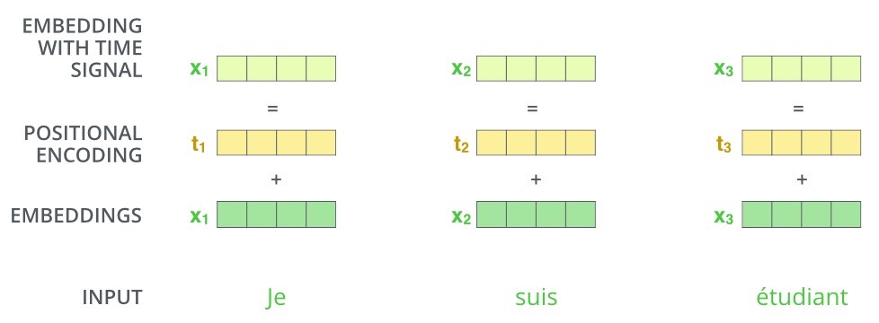
Positional Encoding
Figure 19: Positional Encoding

Slide 23
Positional Encoding
Figure 20: Positional Encoding

Slide 24
Conclusion
Be superior in quality
More parallelizable
Require significantly less time to train
Generalize well

Slide 25
Attention Is Not All You Need
Figure 21: Attention Is Not All You Need

Slide 26
References
[1] Xavier Amatriain. Transformer models: an introduction and catalog, 2023.
[2] Ashish Vaswani, Noam Shazeer, Niki Parmar, Jakob Uszkoreit, Llion Jones, Aidan N. Gomez, Lukasz Kaiser, and Illia Polosukhin. Attention is all you need, 2017.
[3] Jay Alammar. The Illustrated Transformer, 2018.
[4] Yihe Dong, Jean-Baptiste Cordonnier, and Andreas Loukas. Attention is not all you need: Pure attention loses rank doubly exponentially with depth, 2021.
[5] Mu Li. http://zh.d2l.ai/chapter_attention-mechanisms/transformer.html, 2022.
My Personal Website
Yvanwzw.top

Slide 27
THANK YOU!
谢谢!

